Slide 1



LinkHome

Slide 2
Data Structure Used:
We have used Linked list to develop this application for Senior citizens.
Using various operations of linked list, our application can do the following tasks:
1.To check whether the person has reached home successfully.
2.To find the location of the person if he/she has got stuck somewhere.
3.To check the no. of places the person has visited.

Slide 3
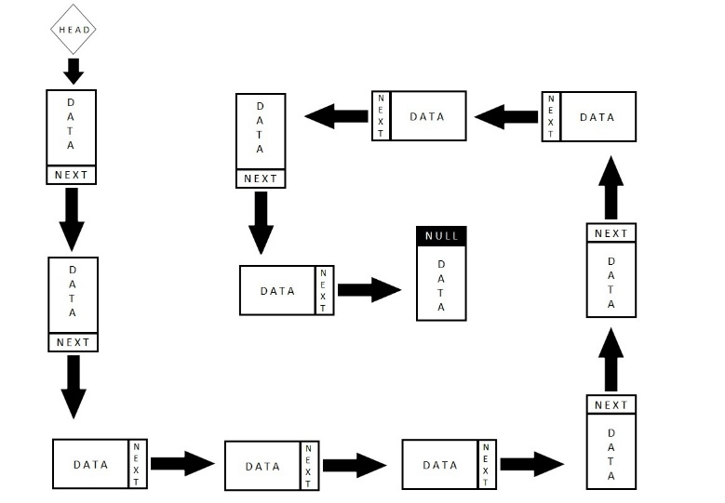

What is Linked list?
A linked list is a sequence of data structures, which are connected together via links. Linked List is a sequence of links which contains items. Each link contains a connection to another link. Linked list is the second most-used data structure after array.
This Photo by Unknown Author is licensed under CC BY-SA

Slide 4

TASK 1:
To check if the person has reached back home successfully!
In this case we have used the operation to check loop in the linked list.
We have used two pointers, one slow pointer and one fast pointer.
Each time when the person changes his/her location, slow pointer gets incremented by 1 and fast pointer gets incremented by 2.
When slow pointer meets fast pointer it indicates that the loop is complete and the person has reached back home successfully.

Slide 5
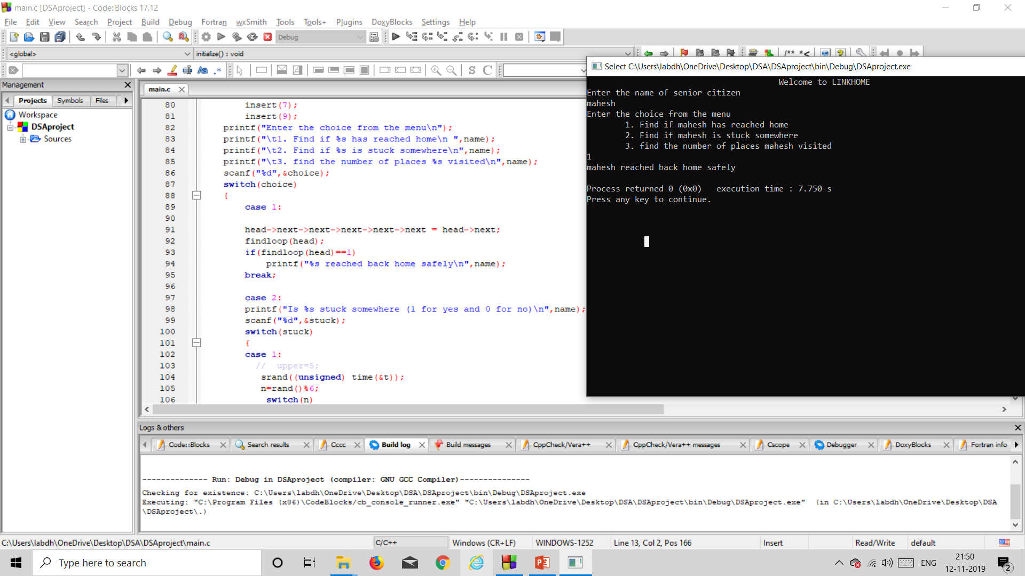

Slide 6

TASK 2:
To find the location of the person if he/she has got stuck somewhere.
Here we have used a normal pointer that starts from home when the stucked person presses 1 on his/her device giving signal of being lost.
The pointer starting from home traverse all the locations and stop where the person has got stuck.
And then a message pops up on the device of the person whose phone no. is registered with the application updating about the location of the lost person.

Slide 7
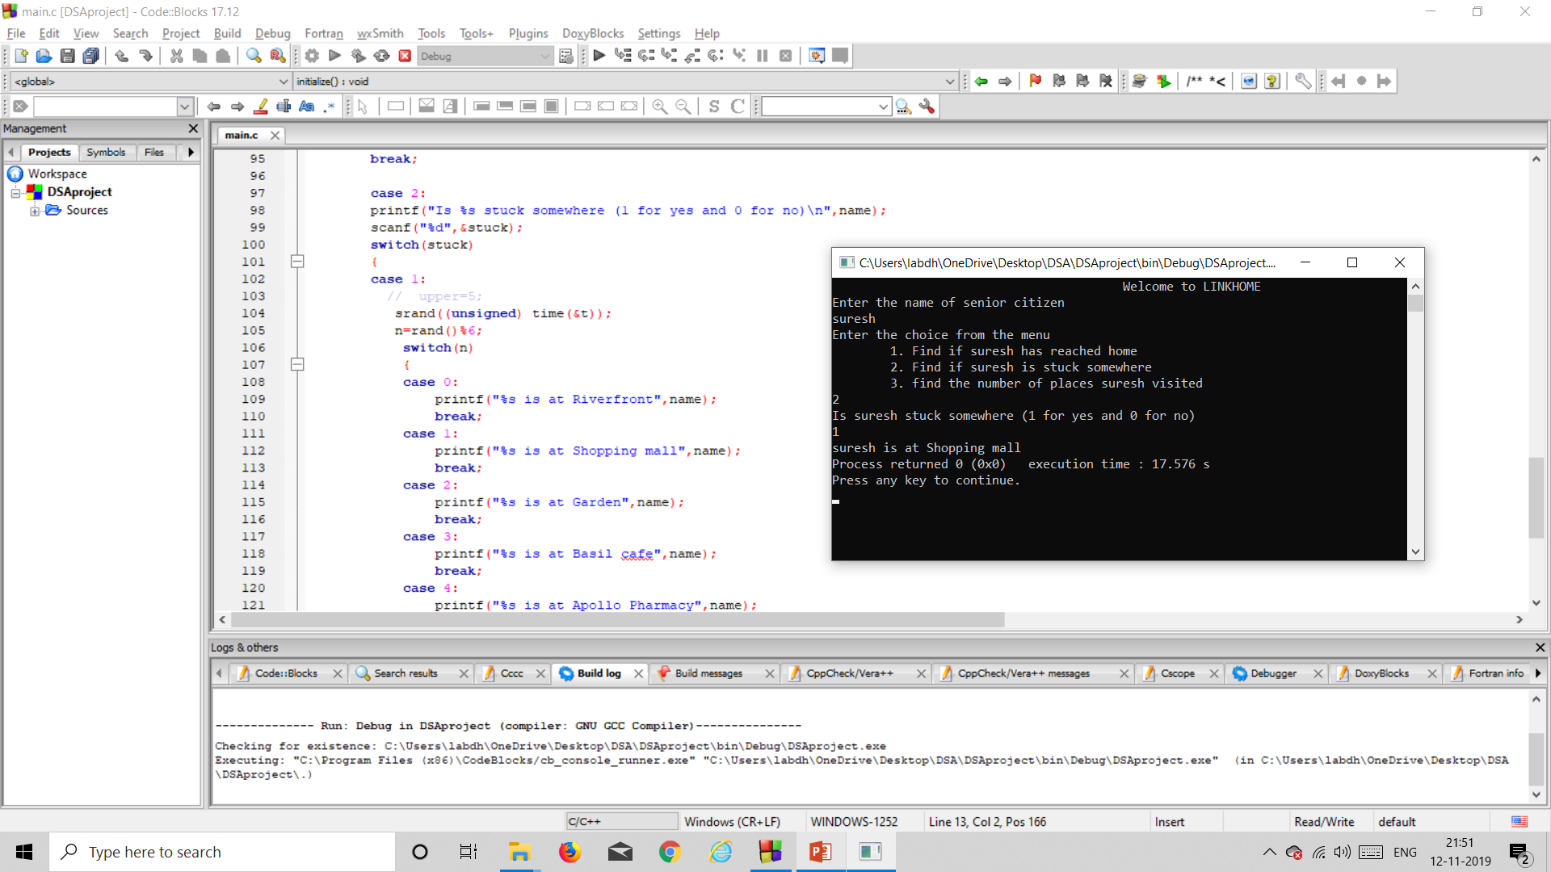

Slide 8

TASK 3:
To check the no. of places the person has visited.
In this case we have used a pointer that keeps updating a variable count as the person changes his/her location.
Once the person has reached back home successfully the count displays the no. of places (as no. of nodes) the person has visited.

Slide 9
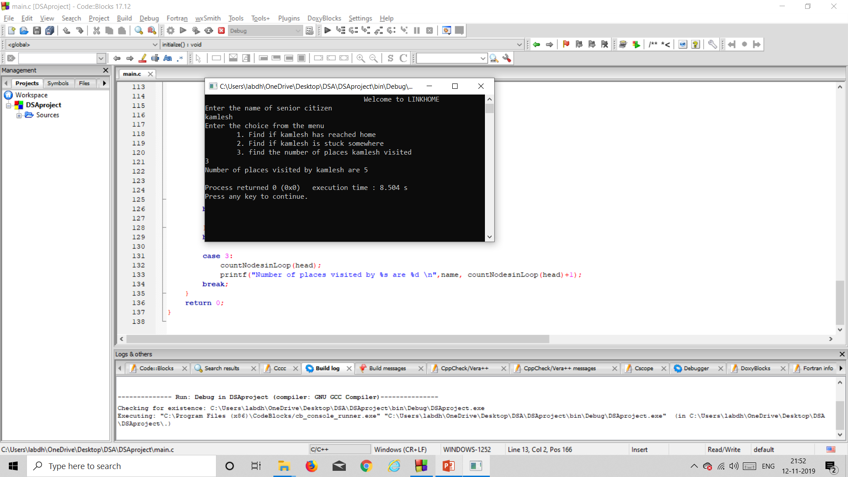

Slide 10

Done By:
18bce101
18bce104
18bce106

